Slide 1

Combinatorial Hodge Theory with Applications
姚 远
北京大学数学科学学院
2014

Slide 2
Recall
Hodge Theory

Slide 3
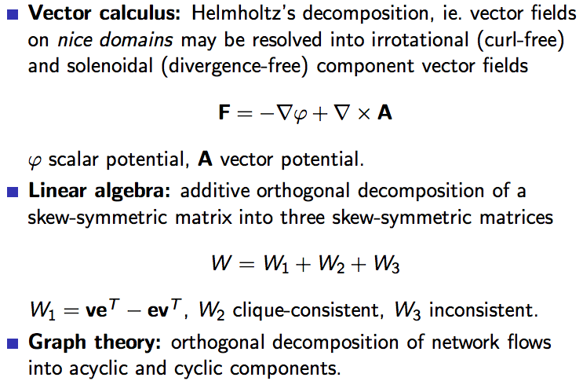
Hodge Decomposition

Slide 4
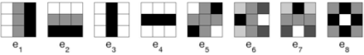
Example I: Visual Image Patches –Point Cloud Data in Metric Spaces
Ann Lee, Kim Pedersen, David Mumford (2003) studies statistical properties of 3x3 high contrast image patches of natural images (from Van Heteran’s database)
Gunnar Carlsson, Vin de Silva, Tigran Ishkhanov, Afra Zomorodian (2004-present) found those image patches concentrate around a 2-dimensional klein bottle imbedded in 7-sphere
They build up simplicial complex from point cloud data
1-D Harmonic flows actually focus on densest region -- 3 major circles

Slide 5
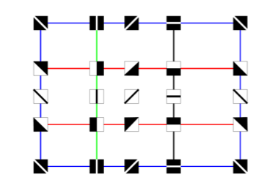
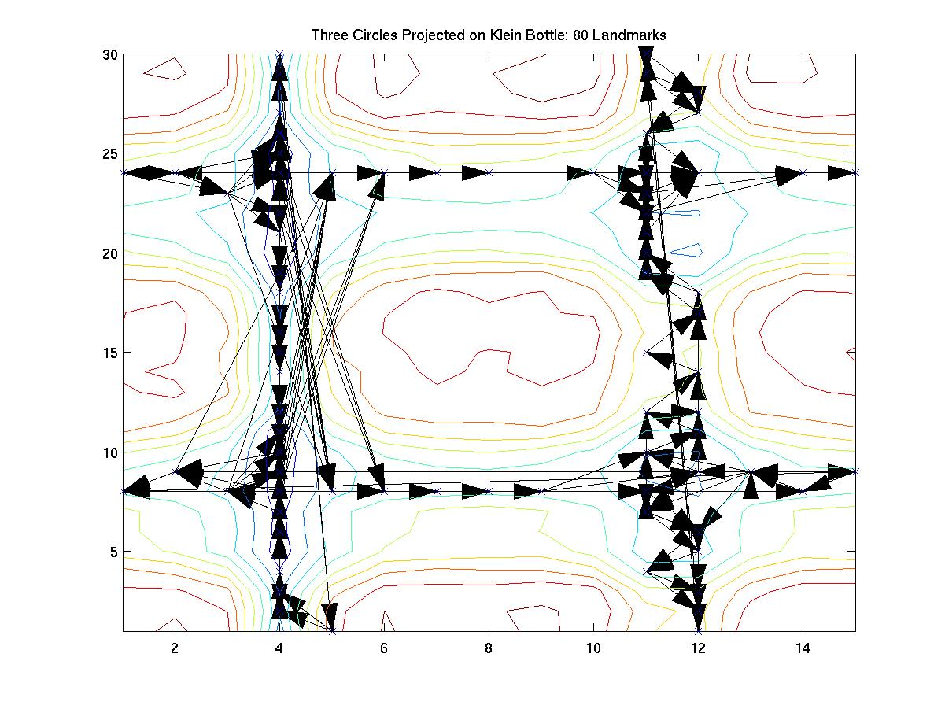
1-D Harmonic Flows on the space of 3x3 Image Patches
Left Upper：Klein Bottle of 3x3 Image Patch Space (Courtesy of Carlsson-Ishkhanov, 2007)
Left Lower：Harmonic flows focus on 3 major circles where most of data concentrate
Some new theory: Bartholdi-Schick-Smale-Smale, 2010, “Hodge Theory on Metric Spaces”, preprint.

Slide 6
Here we will focus on “Ranking”, or “Preference Aggregation” …
Psychology: L. L. Thurstone (1928) (scaling), et al.
Statistics: M. Kendall (1930s, rank corellation), F. Mosteller, Bradley-Terry,…, P. Diaconis (group theory), et al.
Economics: Condorcet (1785), Borda, K. Arrow, A. Sen (voting and social choice theory, Nobel Laureates) et al.
Computer Science: Google’s PageRank, Recommendation in E-commerce, et al.

Slide 7


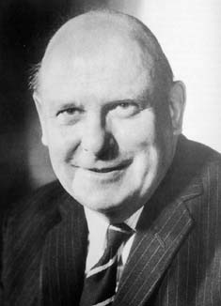
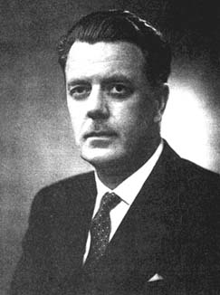

Had William Hodge met Maurice Kendall
_{Hodge Theory}
_{Pairwise ranking}
The Bridge of Sighs in Cambridge, St John’s College
Notes:
A popular approach is to first cluster all the conformations into a large number of small sets of very structurally similar, and therefore likely kinetically similar, conformations called microstates. We then used spectral clustering lump microstates that can interconvert rapidly into larger states called metastable states while conformations separated by large free energy barriers are grouped into different states
7

Slide 8
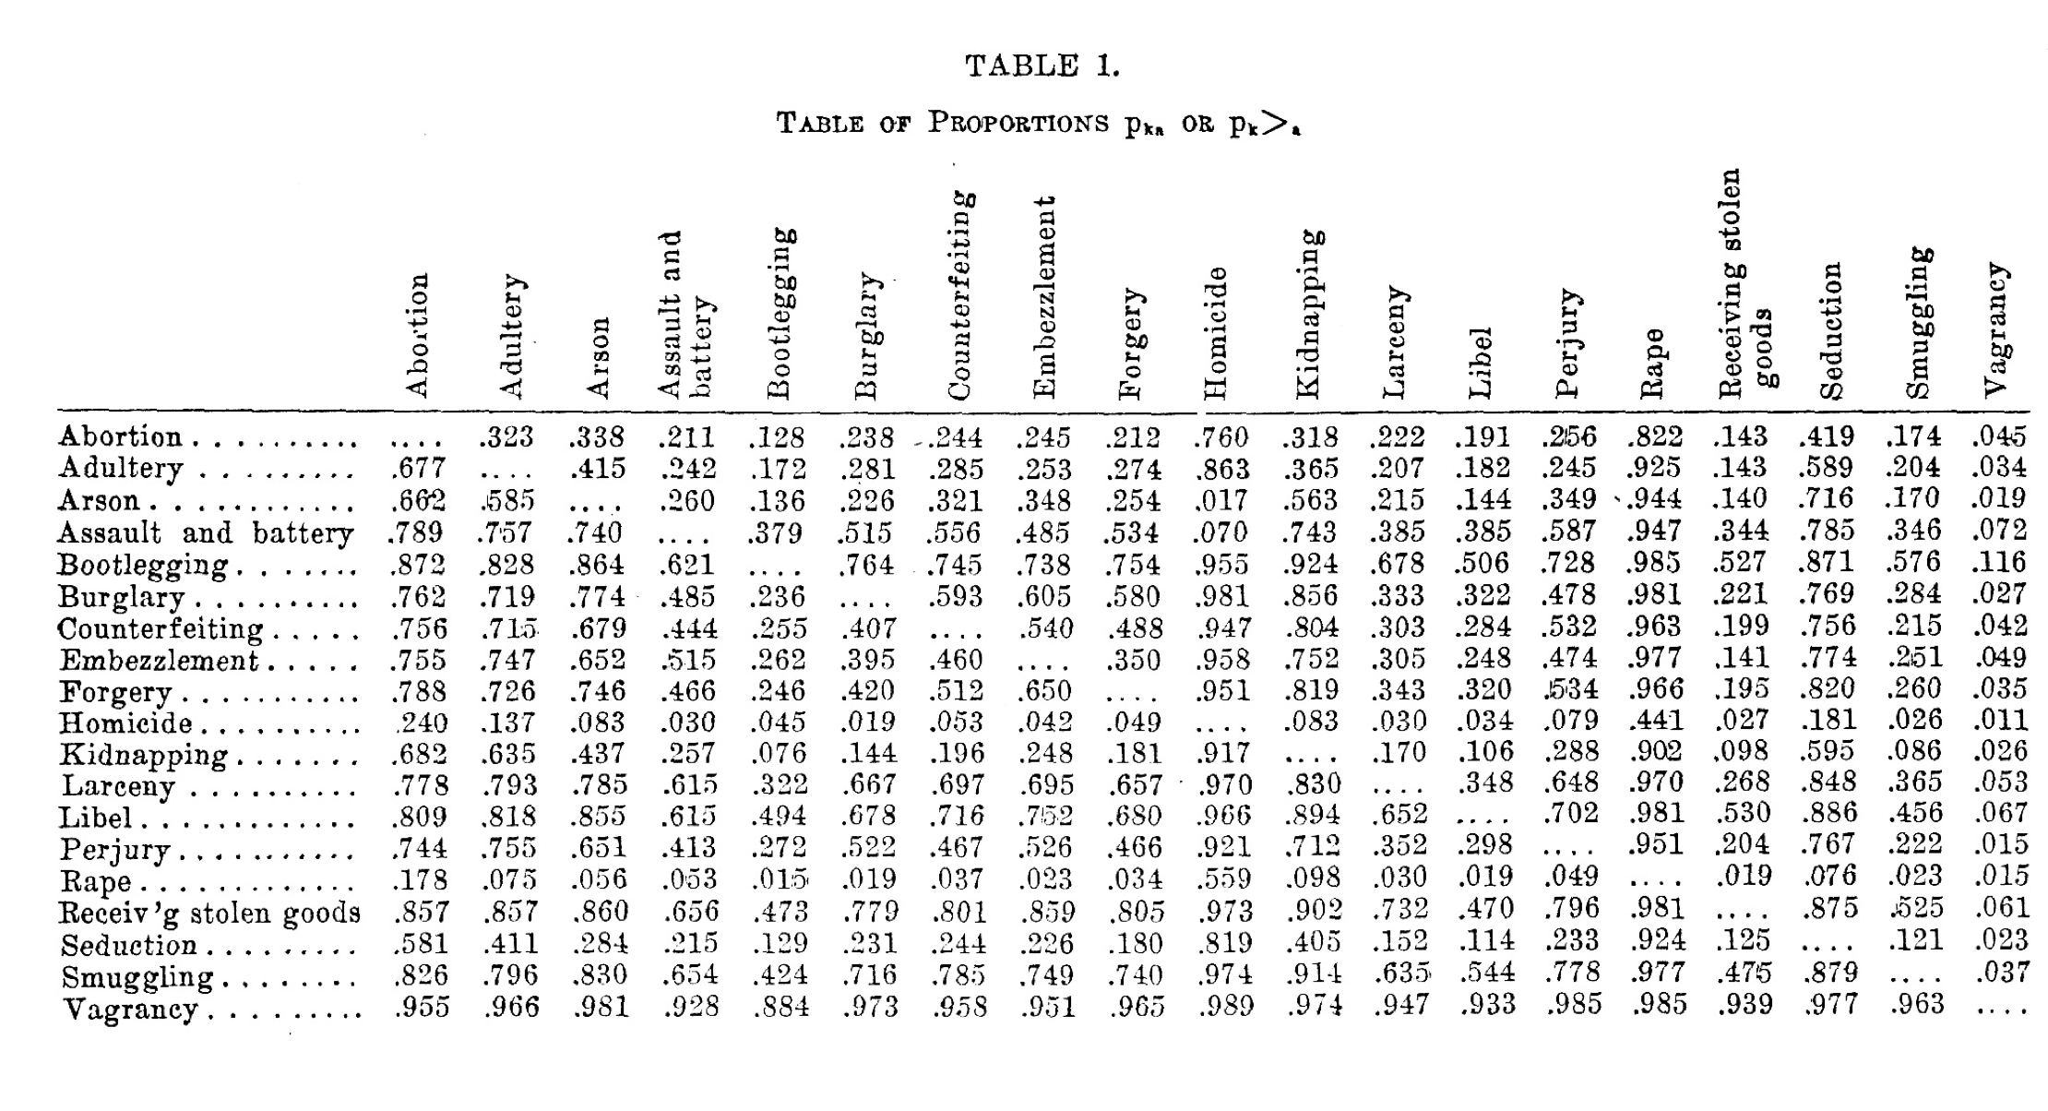
Thurstone’s Crime Scaling in 1928
Can we learn a scale for crimes from pairwise comparisons?
Similar modern problem: wine taste, video quality evaluation, …

Slide 9
Ranking in Economics
STRATEGIES | B Cooperate | B Defect
A Cooperate | (3,3) | (0,5)
A Defect | (5,0) | (1,1)
Prisoner’s dilemma in Game Theory, (Flood-Dresher-Tucker 1950)
Voter 1 | Voter 2 | Voter 3 | Voter 4
A>B>C | B>C>A | C>A>B | …
Voting theory and social choice
Condorcet (1785), Borda (1700s)
Kenneth Arrow (1972 Nobel Memorial Prize in Economics)
Amartya Sen (1998 Nobel Memorial Prize in Economics)

Slide 10

Ranking on Internet
“Multicriteria” ranking/decision systems
Amazon or Netflix’s recommendation system (user-product)
Interest ranking in social networks (person-interest)
S&P index (time-price)
Voting (voter-candidate)
“Peer-review” systems
Publication citation systems (paper-paper)
Google’s webpage ranking (web-web)
eBay’s reputation system (customer-customer)
 | mv1 | mv2 | mv3
usr1 | 1 | - | -
usr2 | 2 | 5 | -
usr3 | - | - | 4
usr4 | 3 | 2 | 5

Slide 11
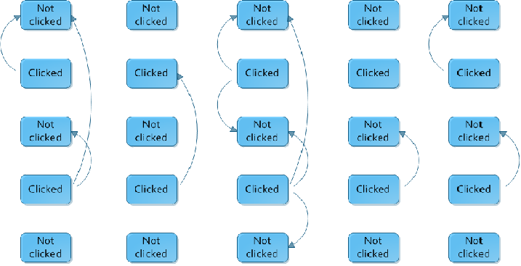
Clicks implies preference

Slide 12
Characteristics
Aforementioned ranking data are often
Incomplete: typically about 1%
Imbalanced: heterogeneously distributed votes
Cardinal: given in terms of scores or stochastic choice
Pairwise ranking on graphs: implicitly or explicitly, ranking data may be viewed to live on a simple graph G=(V,E), where
V: set of alternatives (webpages, products, etc.) to be ranked
E: pairs of alternatives comparable
Look at Hodge decomposition of pairwise comparison edge flows…

Slide 13
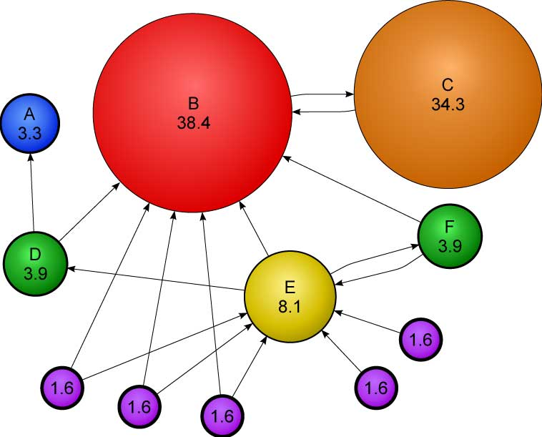
Example I: Pagerank
Model assumption:
A Markov chain random walk on networks, subject to the link structure
Algorithm [Brin-Page’98]
Choose Link matrix L, where L(i,j)=# links from i to j.
Markov matrix M=D⁻¹ L, where D = e^{T} L, e is the all-one vector.
Random Surfer model: E is all-one matrix
PageRank model: P = c M + (1-c) E/n, where c = 0.85 chosen by Google.
Pagerank vector: the primary eigenvector v₀ such that P^{T} v₀ = v₀
Note: SVD decomposition of L gives HITS [Kleinberg’99] algorithm.
Problem: Can we drop Markov Chain model assumption?

Slide 14
Another View on Pagerank
Define pairwise ranking:
Where P is the Pagerank Markov matrix.
Claim: if P is a reversible Markov chain, i.e.
Then

Slide 15
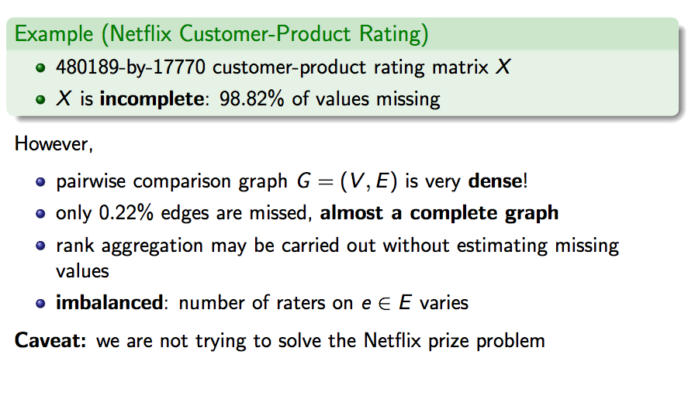
Example II: Netflix Customer-Product Rating

Slide 16
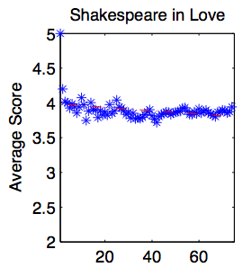
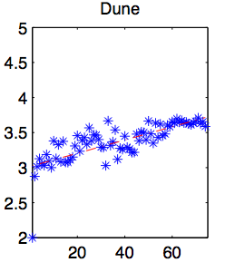
Rank Aggregation
The first order statistics, mean score for each product, is often inadequate because of the following:
most customers would rate just a very small portion of the products
different products might have different raters, whence mean scores involve noise due to arbitrary individual rating scales (right figure)
How about high order statistics?
Notes:
16

Slide 17
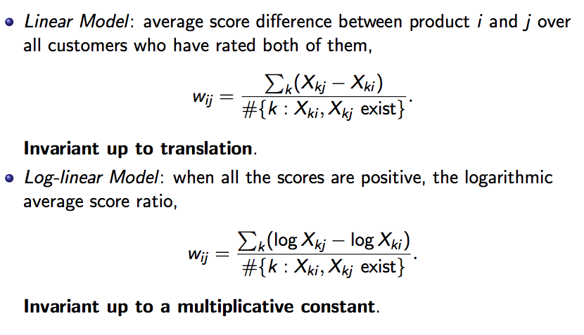
From 1st order to 2nd order: Pairwise Ranking

Slide 18
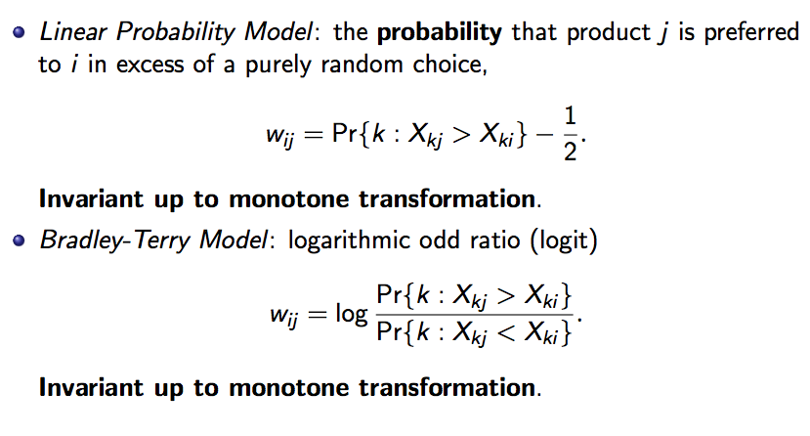
Pairwise Ranking Continued

Slide 19
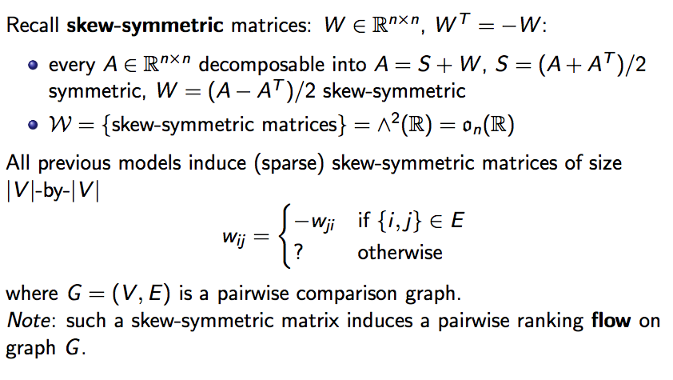
Skew-Symmetric Matrices of Pairwise Ranking

Slide 20
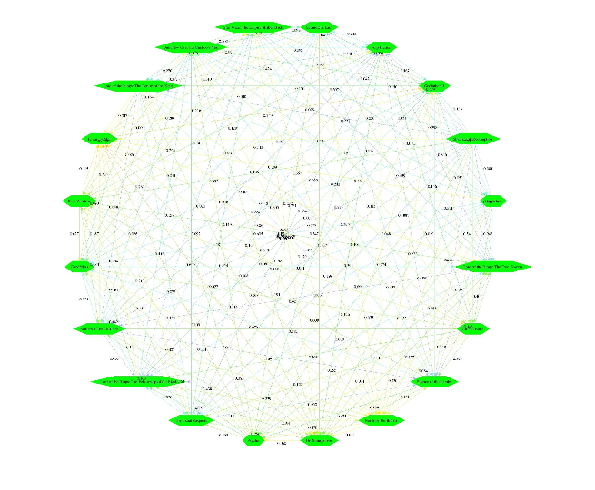
Pairwise Ranking of Top 10 IMDB Movies
Pairwise ranking graph flow among top 10 IMDB movies

Slide 21


Web Link among Chinese Universities
₁₅₉
₅₃
₁₈
₁₇
₃₄
₁₂
2002, http://cybermetrics.wlv.ac.uk/database/stats/data
Link structure correlated with Research Ranking?

Slide 22
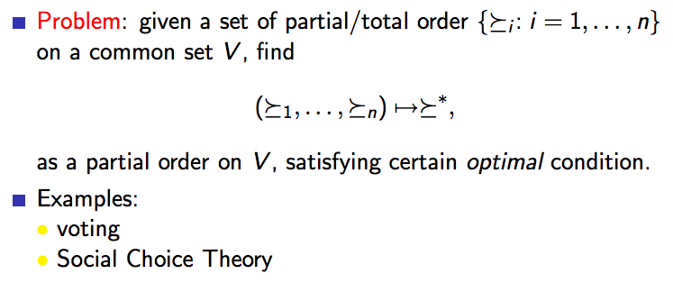
Classical Ordinal Rank Aggregation Problem

Slide 23
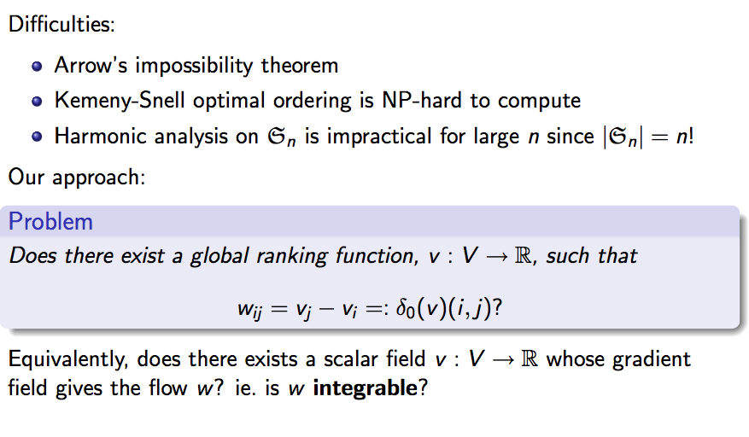
Rank Aggregation Problem
Utility theory for preference.

Slide 24
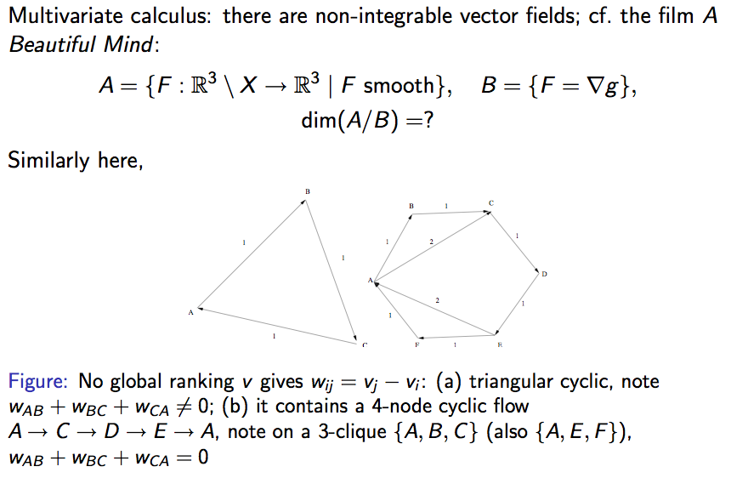
Answer: Not Always!

Slide 25
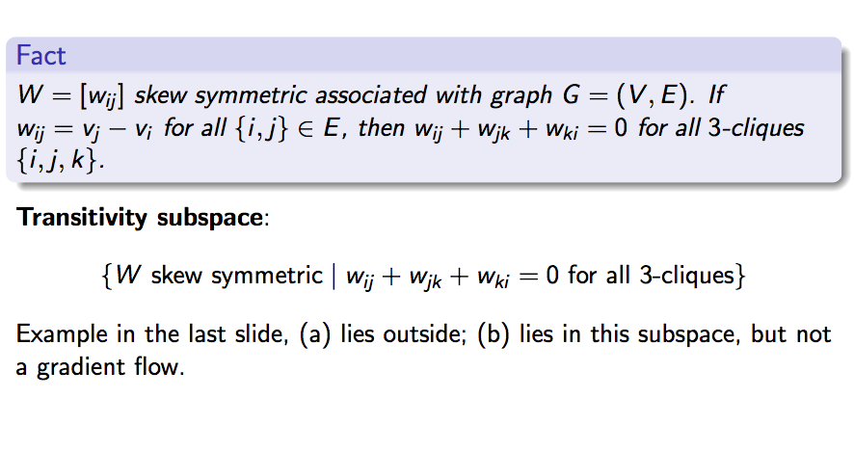
Triangular Transitivity
Ordinal intransitivity: a>b>c>a
Cardinal intransitivity: w_{ab}+w_{bc}+w_{ca} ≠ 0

Slide 26
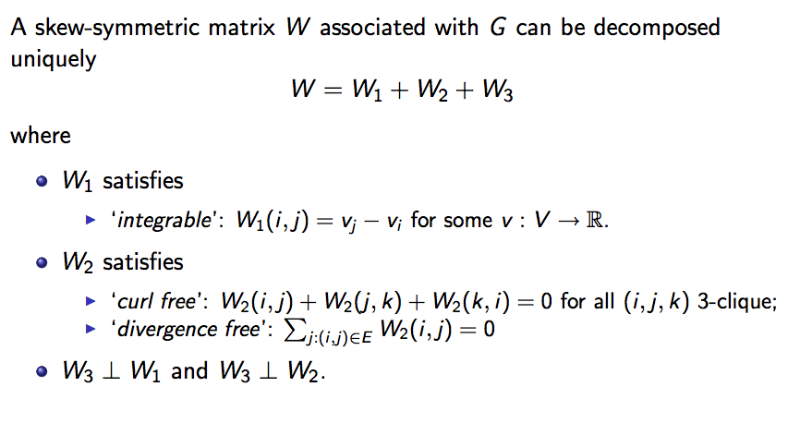
Hodge Decomposition: Matrix Theoretic
Notes:
A popular approach is to first cluster all the conformations into a large number of small sets of very structurally similar, and therefore likely kinetically similar, conformations called microstates. We then used spectral clustering lump microstates that can interconvert rapidly into larger states called metastable states while conformations separated by large free energy barriers are grouped into different states
26

Slide 27
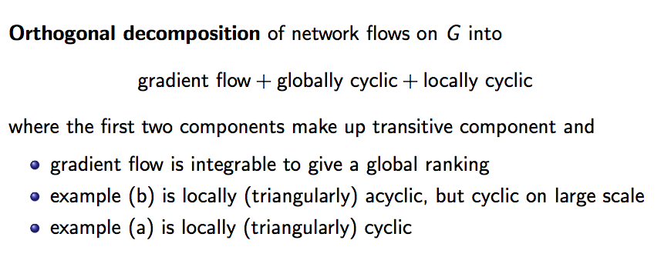
Hodge Decomposition: Graph Theoretic
Notes:
A popular approach is to first cluster all the conformations into a large number of small sets of very structurally similar, and therefore likely kinetically similar, conformations called microstates. We then used spectral clustering lump microstates that can interconvert rapidly into larger states called metastable states while conformations separated by large free energy barriers are grouped into different states
27

Slide 28
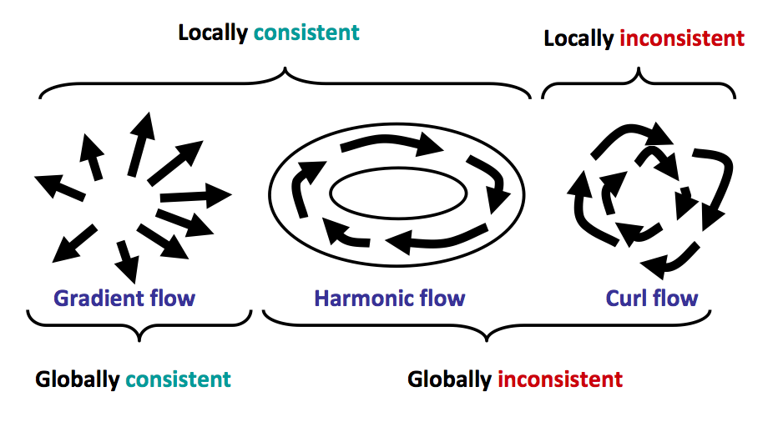
1-D Hodge (Helmoholz) Decomposition Cartoon
Courtesy of Asu Ozdaglar, MIT
Notes:
Including those not in any density level
28

Slide 29
Combinatorial Hodge Theory: Geometric Analysis on Graphs (and Complexes)
图(复形)上的几何分析
Notes:
Levy model: within the temperature, the forward backward microscopic rate contant equal 1. The states reflect the thermodynamics of the system in that their density at each temperature is related to the energy according to the Boltzmann distribution. We choose microscopic rate constants so that the kinetic model preserves this distribution at equilibrium for each replica exchange temperature.
29

Slide 30
Combinatorial Hodge Theory
Build a simplicial complex (Graph as 1-skeleton) from data
Clique complex (Cech, Vietoris-Rips, Witness, …)
Functions on simplicial complex as alternating forms
global ranking as 0-form on vertices
pairwise ranking as 1-form on edges
Boundary/coboundary operators
gradient vs. divergence
curl vs. triangular boundary
Combinatorial Laplacians and Hodge Decomposition
Notes:
30

Slide 31
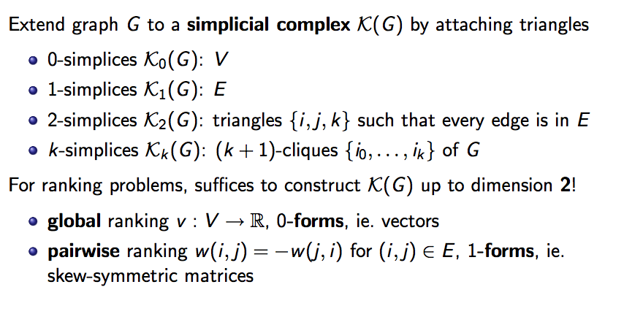
Clique Complex of a Graph
Notes:
Including those not in any density level
31

Slide 32
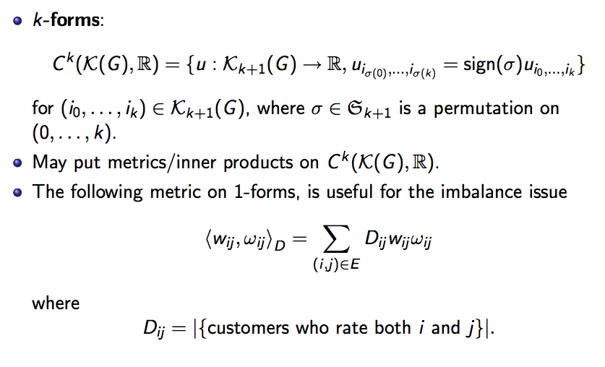
Discrete Differential Forms
Notes:
Including those not in any density level
32

Slide 33
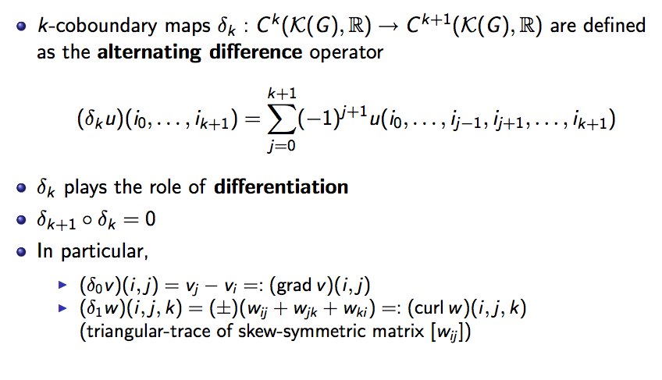
Discrete Exterior Derivatives: coboundary maps
Notes:
Including those not in any density level
33

Slide 34
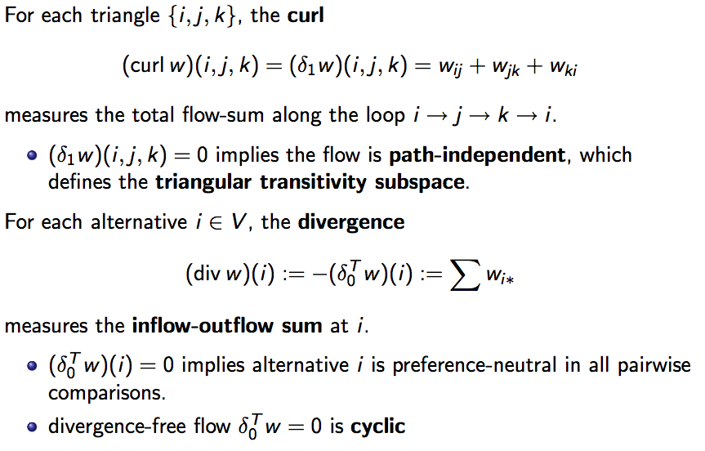
Curl (旋度) and Divergence (散度)
Notes:
Including those not in any density level
34

Slide 35
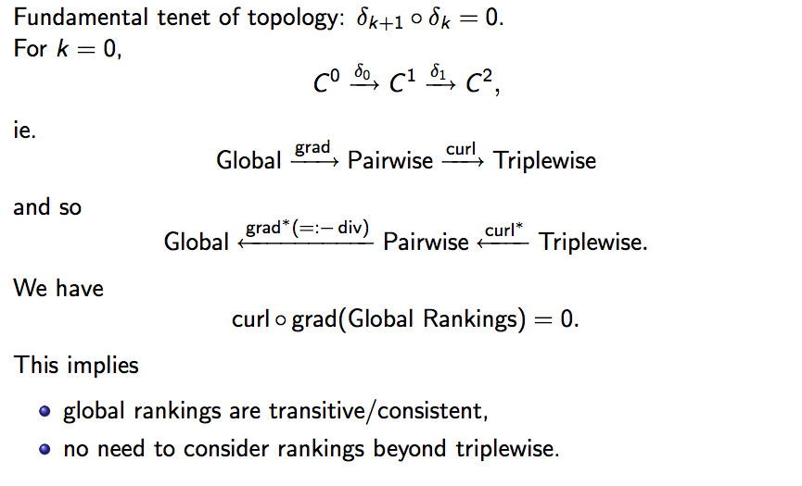
Basic Alg. Top.: Boundary of Boundary is Empty
Notes:
Including those not in any density level
35

Slide 36
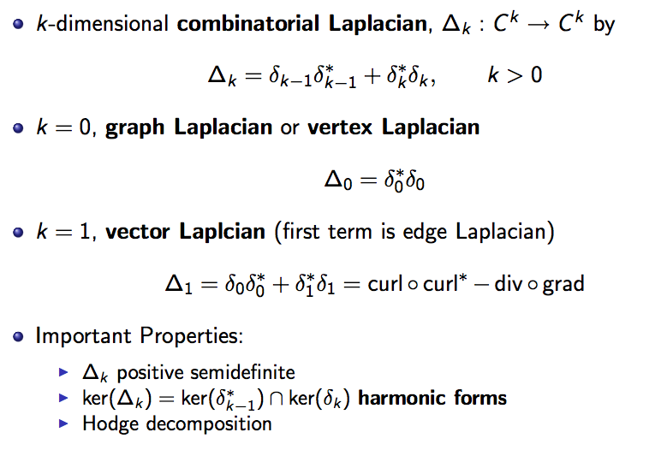
High Dim. Combinatorial Laplacians
Notes:
Including those not in any density level
36

Slide 37
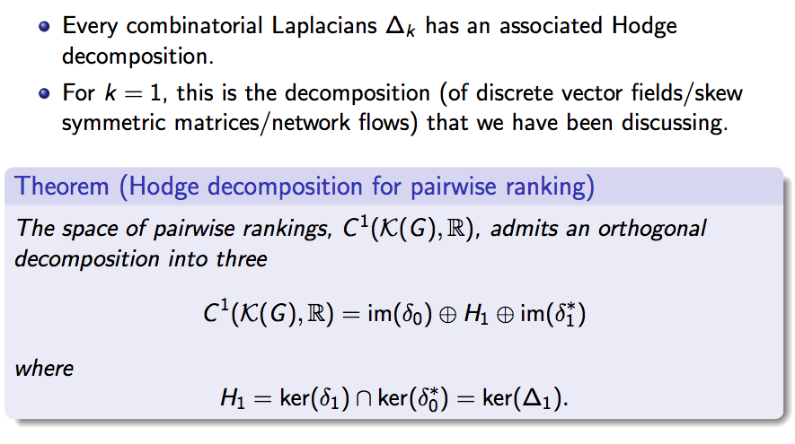
Hodge Decomposition Theorem
Notes:
Including those not in any density level
37

Slide 38
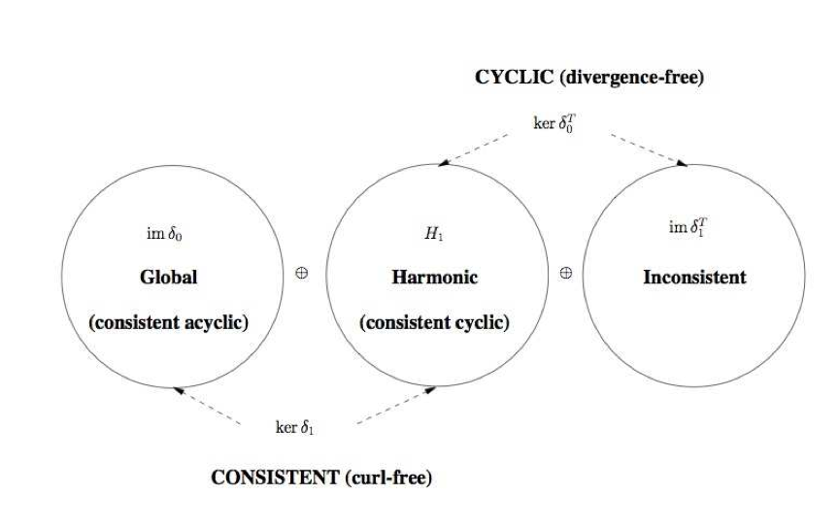
Hodge Decomposition Theorem
Notes:
Including those not in any density level
38

Slide 39
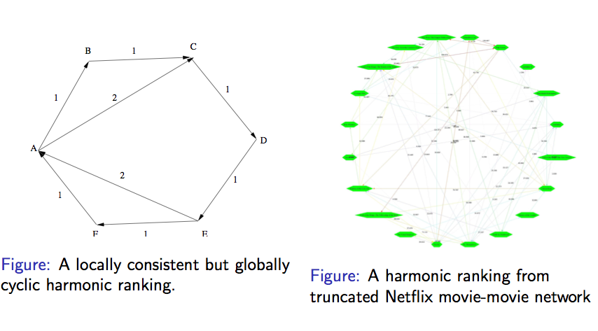
Harmonic rankings: locally consistent but globally inconsistent (circular coordinate)
Notes:
Including those not in any density level
39

Slide 40
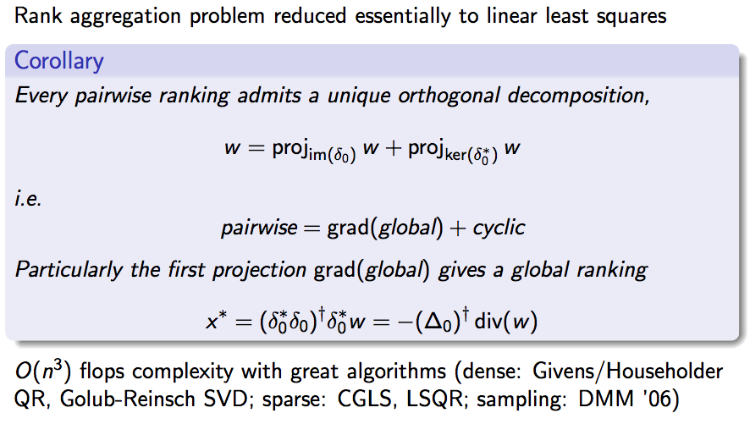
Rank Aggregation as Projection
Notes:
Including those not in any density level
40

Slide 41
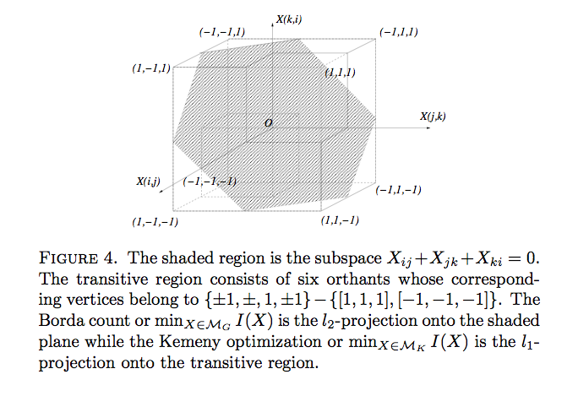
Don Saari’s Geometric Illustration of Different Projections
Notes:
Including those not in any density level
41

Slide 42
Measuring Inconsistency by Curls
Define the cyclicity ratio by
Relative curl
This measures the total inconsistency within the data and model w.
which equals to 1 iff {i,j,k} is a combinatorial intransitive triangle.
Notes:
Including those not in any density level
42

Slide 43
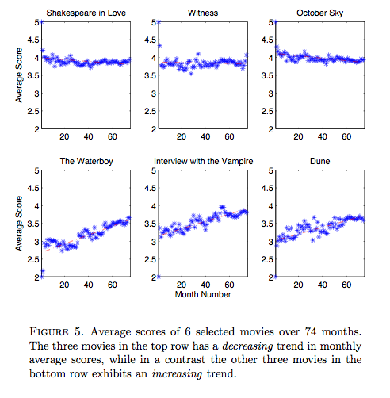
Application: 6 Movies with Dynamic Drifts
Notes:
Including those not in any density level
43

Slide 44
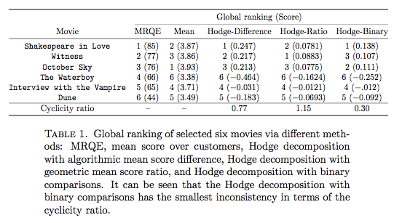
Model Selection by Cyclicity Ratio
MRQE: Movie-Review-Query-Engine (http://www.mrqe.com/)
Notes:
Including those not in any density level
44

Slide 45
Just for fun: Chinese Universities (mainland) Ranking
Rank | Research 2002 | Pagerank | HITS Authority | HITS Hub
Pku.edu.cn | 1 | 2 | 2 | 1
Tsinghua.edu.cn | 1 | 1 | 1 | 6
Fudan.edu.cn | 3 | 7 | 50 | 21
DATA: 2002, http://cybermetrics.wlv.ac.uk/database/stats/data
Notes:
Including those not in any density level
45

Slide 46
Application II: Hodge Decomposition of Games
Every strategy profile is a node in a graph
Two strategy profile is comparable iff only 1 player’s strategy changed
The edge flow is that player’s utility difference
2
(c,c)
(c,d)
STRATEGIES | B Cooperate | B Defect
A Cooperate | (3,3) | (0,5)
A Defect | (5,0) | (1,1)
2
1
1
Note: Prisoner’s dilemma is a potential
game to its Nash equilibrium, not efficient!
So we want new way for flow construction...
(d,c)
(d,d)
Candogan-Menache-Ozdaglar-Parrilo, 2010, Flows and Decompositions of Games: Harmonic and Potential Games, arXiv: 1004.2405v1, May 13, 2010.

Slide 47
Hodge Decomposition of Finite Games
The flows defined above preserve Nash equilibrium
Every player’s utility can be normalized to mean zero, without changing the flow and thus Nash Equilibrium
The residue of mean-zero utility from the original utility is called non-strategic games

Slide 48
Hodge Decomposition of Finite Games =

Slide 49
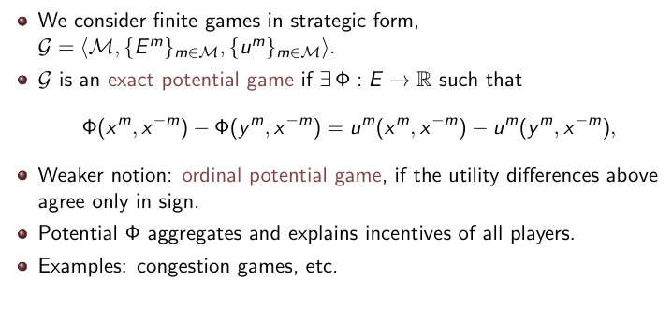
Potential Games

Slide 50
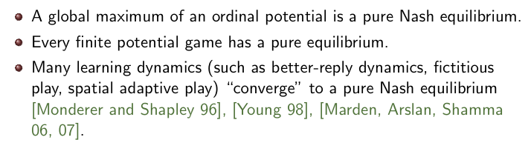
Potential Games

Slide 51
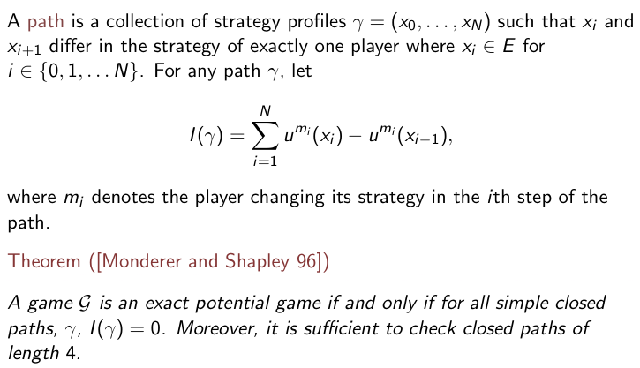
Monderer-Shapley Condition

Slide 52
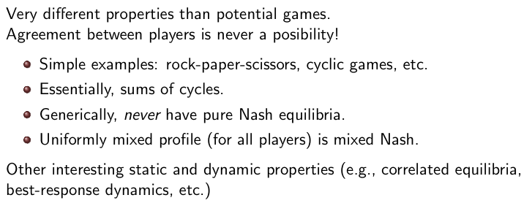
Harmonic Games as Orthogoal Complement of Potential Games

Slide 53
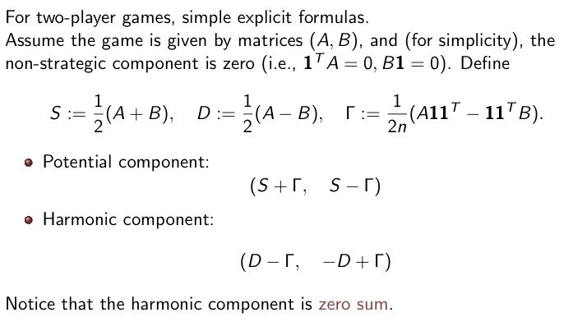
Bimatrix Games

Slide 54
Reference
Jiang, Lim, Yao, and Ye (2011). Statistical Ranking and Combinatorial Hodge Theory, Mathematical Programming, 127(1):203-244.
Candogan, Menache, Ozdaglar, and Parrilo (2011). Flows and Decompositions of Games: Harmonic and Potential Games. Mathematics of Operations Research.
[Friedman1996] J. Friedman, Computing Betti Numbers via Combinatorial Laplacians. Proc. 28th ACM Symposium on Theory of Computing, 1996. http://www.math.ubc.ca/~jf/pubs/web_stuff/newbetti.html
[Forman] R. Forman, Combinatorial Differential Topology and Geometry, New perspective in Algebraic Combinatorics, MSRI publications, http://math.rice.edu/~forman/combdiff.ps
[David1988] David, H.A. (1988). The Method of Paired Comparisons. New York: Oxford University Press.
[Saari1995] D. Saari, Basic Geometry of Voting, Springer, 1995
54

